Slide 1
Cross-Platform Mobile Application Development
B.Sc. Web Technologies & Programming
Department of Computer Science & Applied Physics

Slide 2
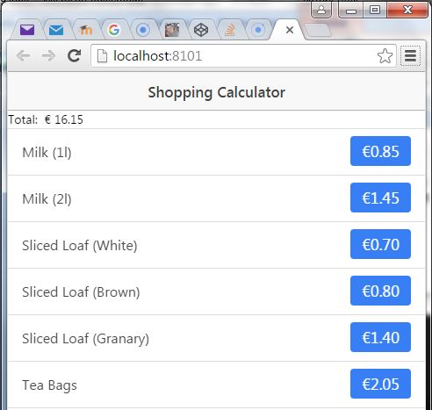
Create the following App

Slide 3
What is involved in creating the app?
HTML File
Heading
A place to display the total
List of shopping items
Text
Button
JavaScript File
Some way of knowing when a particular button is pressed
A variable to keep track of the total
A way of displaying the new total.

Slide 4
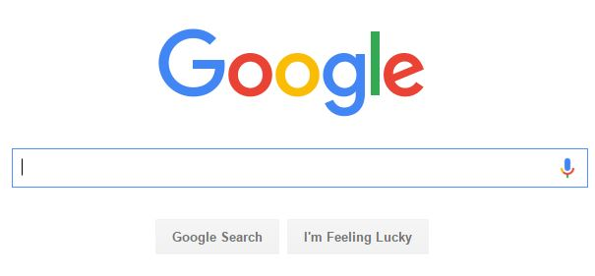
What Else?
APIs
Documentation
Examples
Better ways of doing things
Learning from mistakes other developers have made

Slide 5
List
A html list used in Ionic is ion-list
Look at the Ionic Components site for examples of buttons
When a button is clicked we will want to run a function to update the total price

